Slide 1
Disaster Recovery for PostgreSQL on Kubernetes
Sergey Pronin, Percona

Slide 2
Intro
Why Kubernetes?
Use cases
PostgreSQL on Kubernetes
Operators
High Availability
Disaster Recovery

Slide 3
Why Kubernetes
Bare-metal -> VMs -> Containers
  Orchestration with Kubernetes
CNCF data (2020 survey)
  91% use k8s, 83% in production
Data on Kubernetes data (2021 report)
  70% already run stateful apps on Kubernetes
Percona sees demand
  Community and customers

Slide 4
Use cases
The Good
The Bad and the Ugly
Something as a service
  Platforms
  DBaaS
Dev/test
Repeatable deployment
Kubernetes shop
Huge main frame or monolith
“I heard k8s is good”
One DB, one app
  Startup

Slide 5
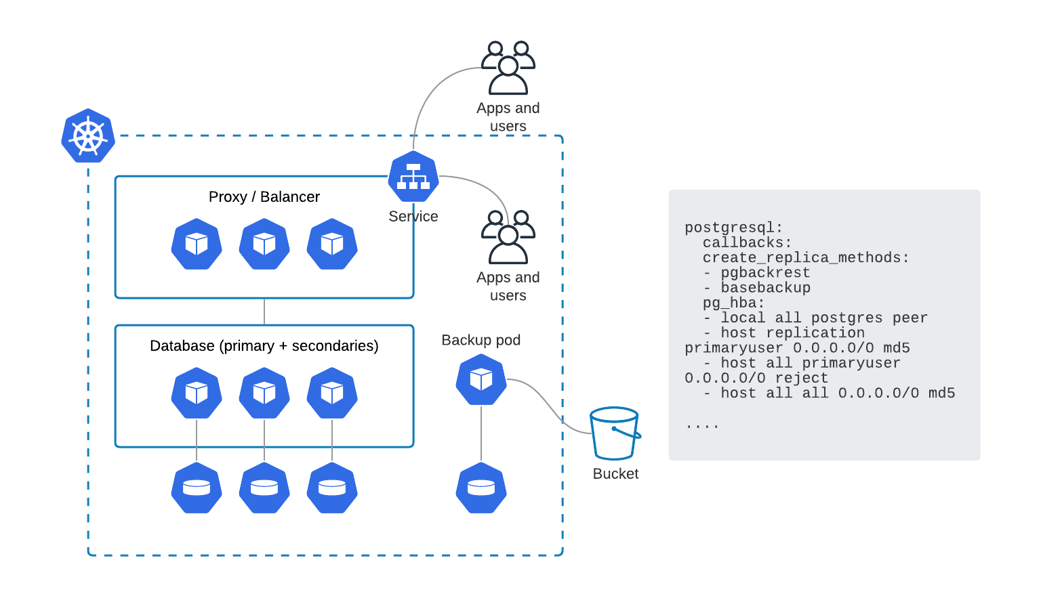
PostgreSQL on Kubernetes
2 main pieces
Kubernetes primitives
Configuration
Day-1 and Day-2 operations
Deploy?
Manage?

Slide 6
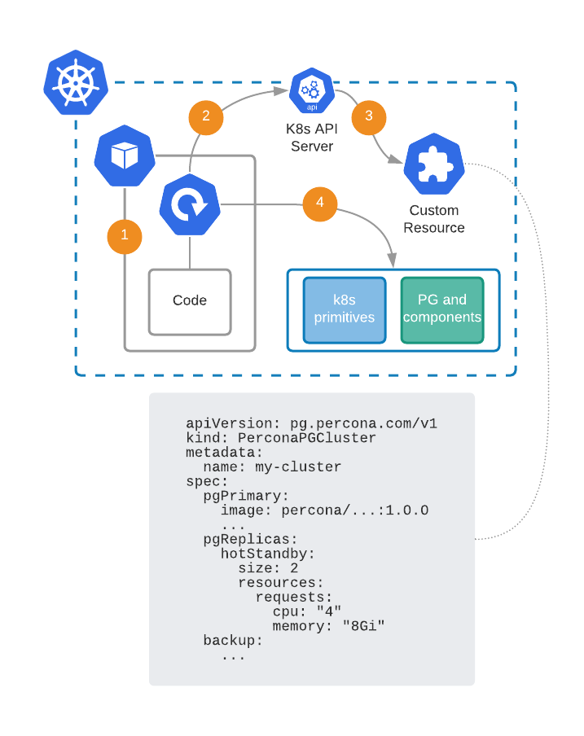
Operators
Operator is a Pod
Reconcile loop checks k8s API for Custom Resource (CR)
k8s controllers are aware of CR creation or changes
Operator’s code provisions and manages
  k8s primitives
  DB and components configuration

Slide 7
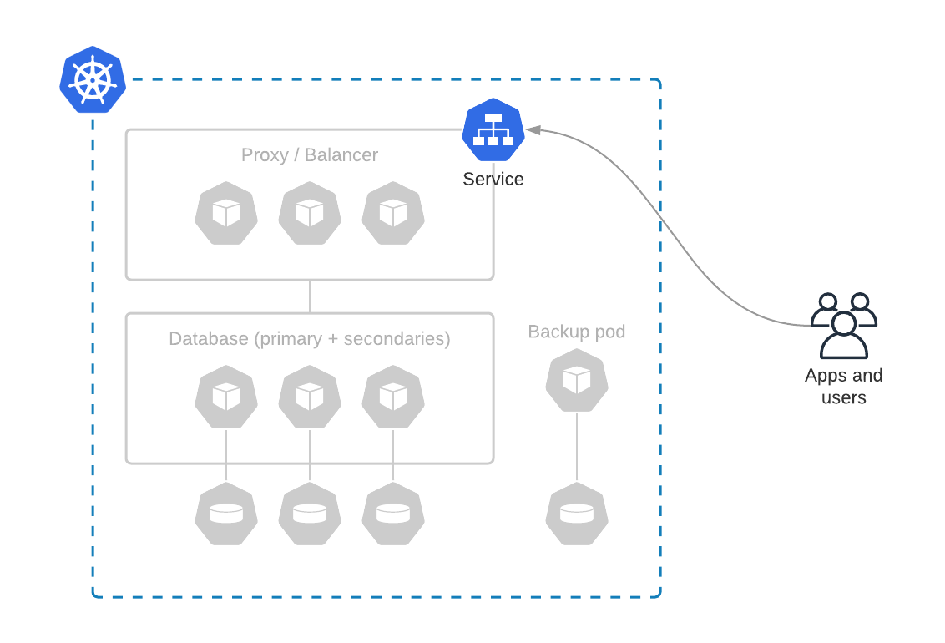
Give me a service
End-state: user gets the service
Automated deployment
Day-2 operations are taken care of
  backups
  scaling
  upgrades

Slide 8
High-availability ≠ Disaster Recovery

Slide 9
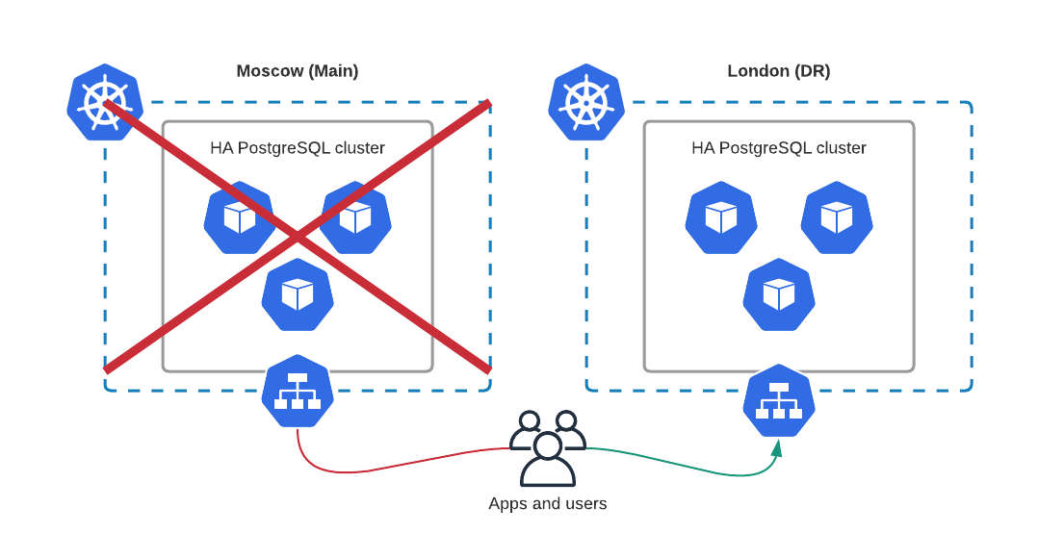
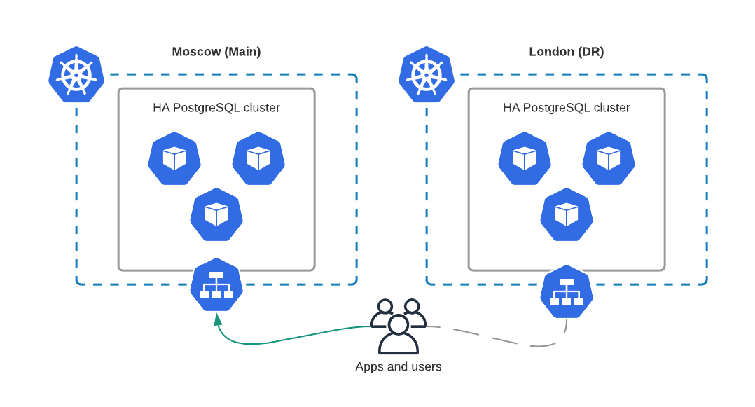
Disaster Recovery

Slide 10
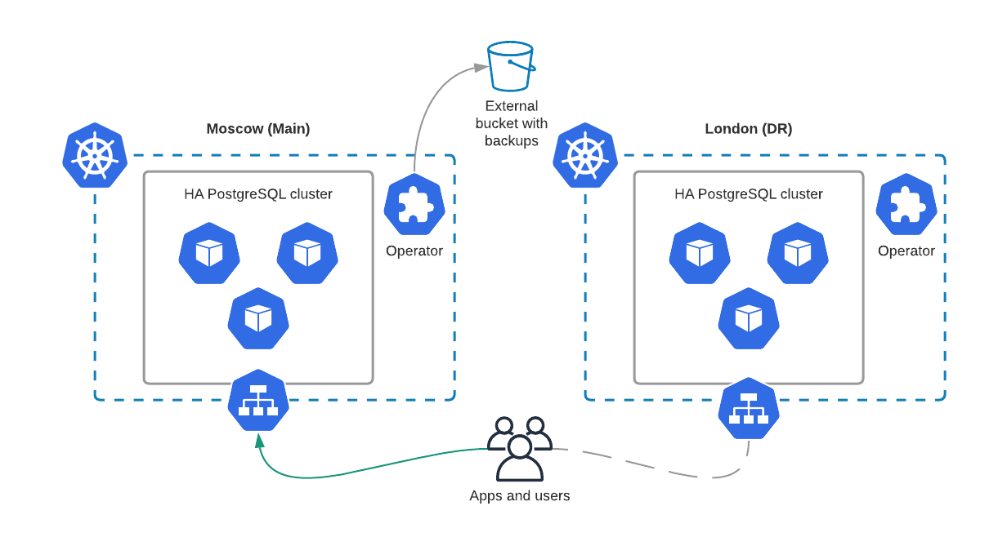
Disaster Recovery - backups
Pros
simple
Cons
long recovery
RTO/SLA breach

Slide 11
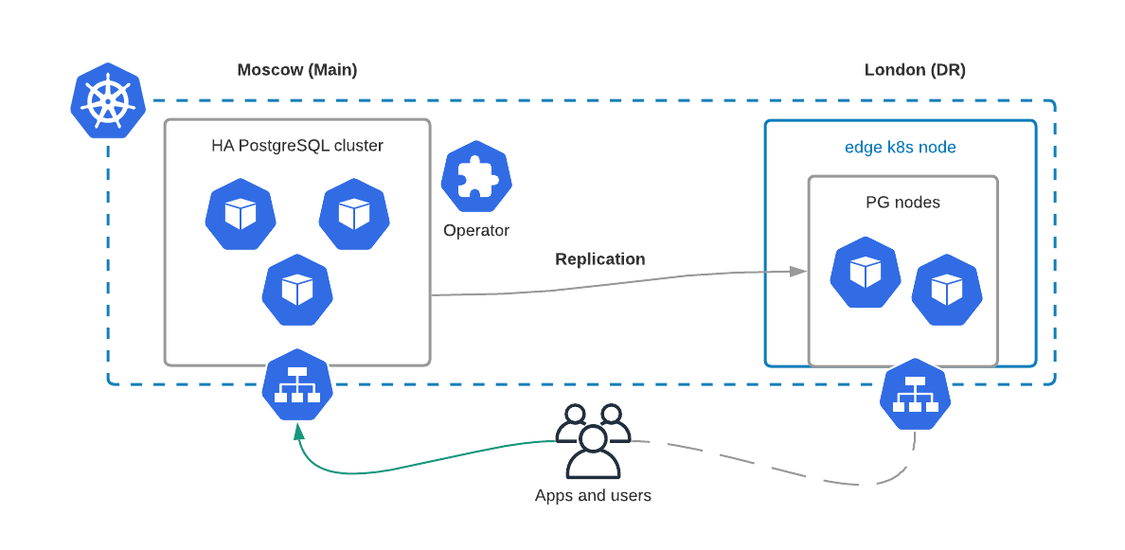
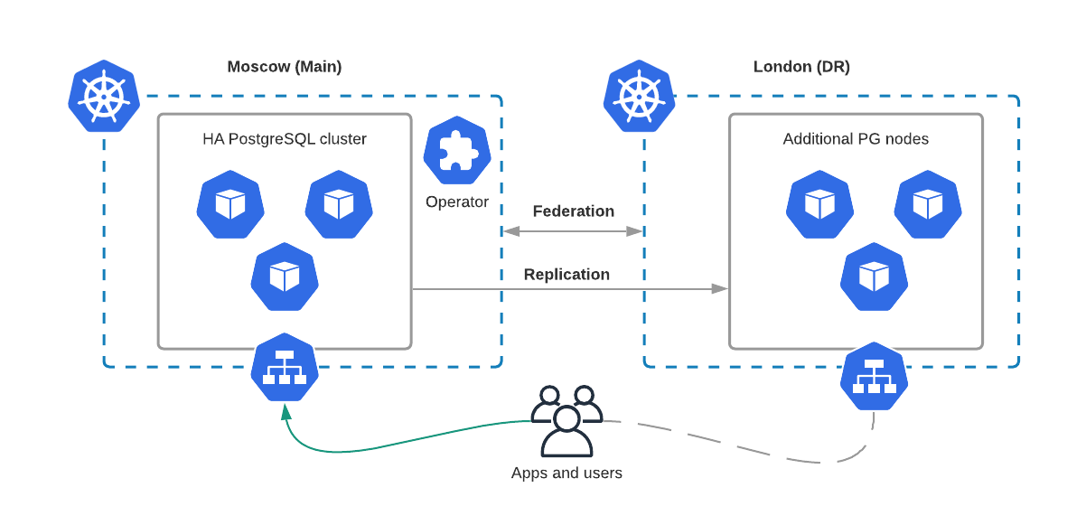
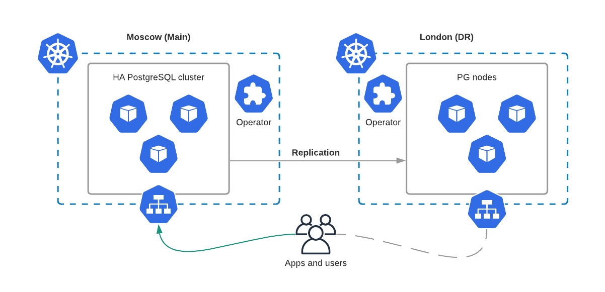
Disaster Recovery - replication
Pros
looks simple
MCS is coming
Pros
native PG way
Pros
k8s takes care of everything
Cons
Kubefed is dead
Cons
Lots of logic in Operator
Cons
Single Points of Failure
Federation
Two Operators
Edge nodes

Slide 12
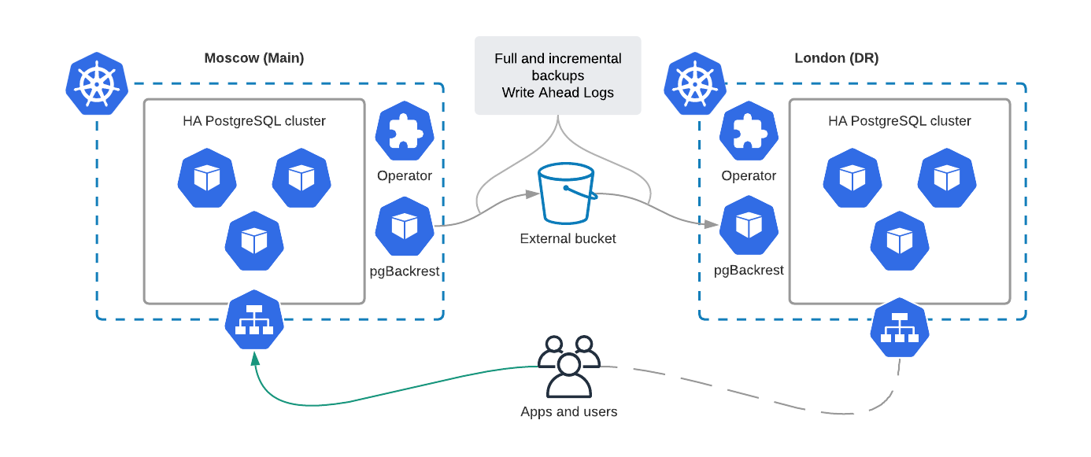
Disaster Recovery - pgBackrest

Slide 13
Q&A
Thanks!
Any questions?
You can find me at:
Twitter: @sergeypronin
sergey.pronin@percona.com

